Slide 1
Protected Habitats and Species
Sustainable Land Management
Dr Olivia Norfolk

Slide 2
Is classifying species and habitats important?
What is the ultimate purpose?
Does it benefit conservation?

Slide 3

Classification facilitates regulation
Nature is a shared resource
Susceptible to over-exploitation
“Tragedy of the Commons”
Classifying species and habitats according to their value or rarity is essential for supporting protective legislation

Slide 4



Protecting our shared resources
International legislation has had a strong influence on UK national environmental policy
Ensures that nations are working towards shared goals
Which habitats and species have been designated protected status?
What legislation is in place to protect them?

Slide 5

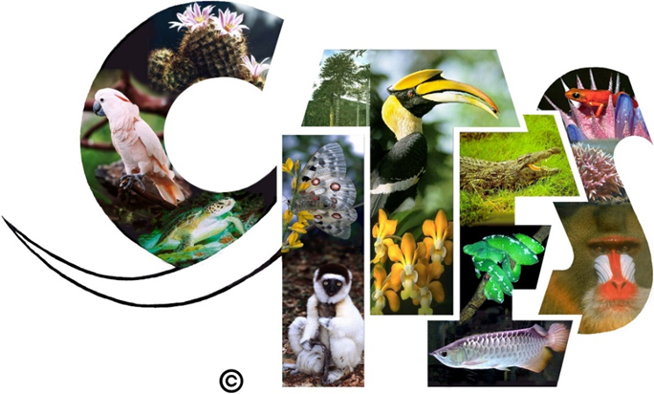


INTERNATIONAL
Ramsar Convention (1971): A global network of coastal and inland wetlands.
CITES - Convention on Trade in Endangered Species of Wild Fauna and Flora (1973): Protects approximately 5,600 animal and 30,000 plant species against over-exploitation through international trade.
Convention on the Conservation of Migratory Species of Wild Animals (1979): Encourages international cooperation to protect threatened migratory species.
United Nations Convention on Biological Diversity (1999): To develop national strategies for the conservation and sustainable use of biological diversity.
.
Notes:
Many of our british legislation has been influenced by international targets
Examples of important internation legislation include the

Slide 6
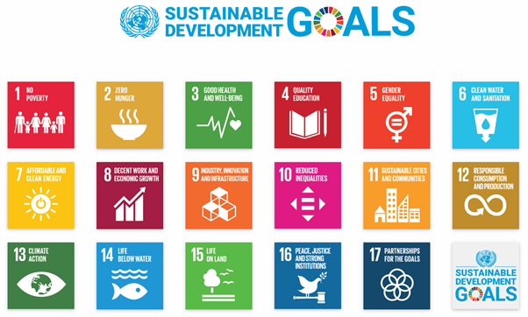

Slide 7

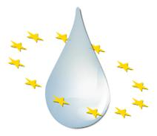
EUROPEAN
Bern Convention (1979): Gave special protection for listed animals (including birds), plants and their habitats.
Birds Directive (1979): Aims to protect all of the 500 wild bird species naturally occurring in the European Union.
Habitats Directive (1992): A network of sites across Europe that protects habitats and species most considered in need of conservation (excluding birds).
EU Water Framework Directive (2000): UK government must maintain good ecological quality of rivers, lakes, coastal waters and groundwater. Judged by water chemistry, hydro-morphology and plant & animal diversity.
.
Notes:
Many of our british legislation has been influenced by international targets
Examples of important internation legislation include the

Slide 8

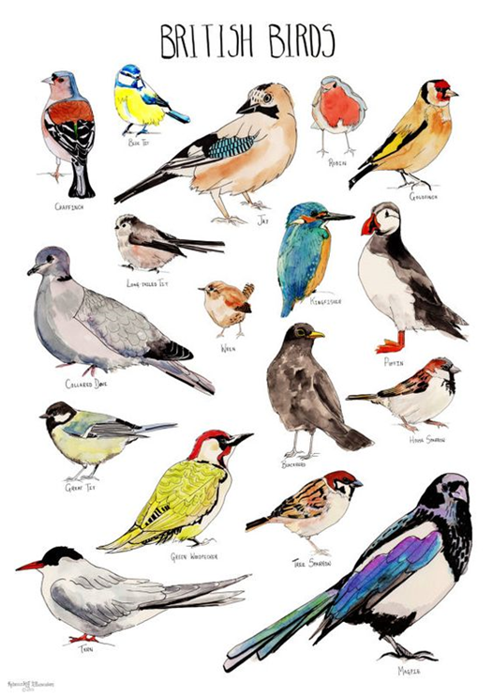
BIRDS DIRECTIVE
Annex 1:
Lists 194 species classified as particularly threatened.
Member States must designate Special Protection Areas (SPAs) to protect these birds and their habitats.

Slide 9
Habitats DIRECTIVE
Annex I
List of habitats classified as particularly threatened (78 in UK).
Annex II
List of species classified as particularly threatened (43 in UK).
Member States must designate Special Areas of Conservation (SACs) to protect them.

Slide 10
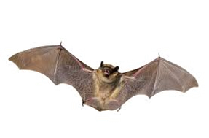
Habitats DIRECTIVE
Also enforces strict protection of Annex IV species
e.g. bats, whales, otters, wild cats, dormouse, smooth snake, natterjack toad, large blue butterfly, lady’s-slipper orchid.
Regulates exploitation of Annex V species
e.g. seals, frogs, freshwater crayfish, pearl mussel, medicinal leech.

Slide 11

NATIONAL
National Parks and Access to the Countryside Act (1949)
Created National Parks and SSSIs SSSI = Site of Special Scientific Interest.
Wildlife and Countryside Act (1981)
Strengthened SSSI and species protection in line with international obligations - Bern convention & Bird directive.
Environmental Protection Act (1990)
Tightened regulations for waste management and emissions.
Marine and Coastal Access Act (2009)
Set up Marine Conservation Zones (MCZs) and licences for fisheries.
.
Notes:
Many of our british legislation has been influenced by international targets
Examples of important internation legislation include the

Slide 12

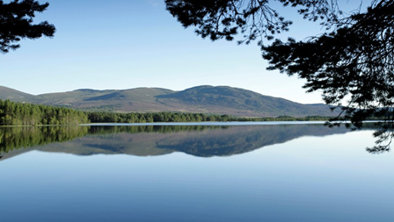
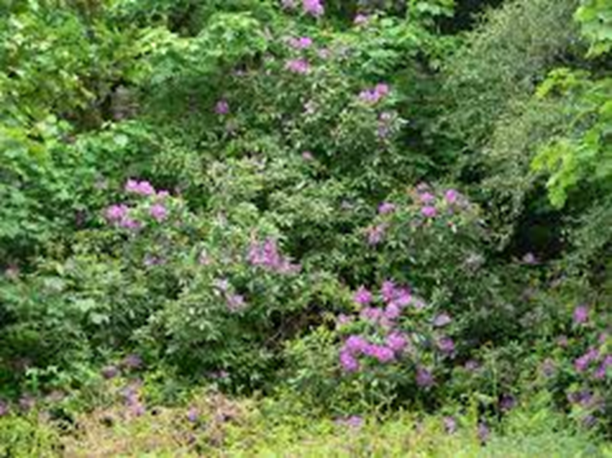
SCOTLAND
Wildlife and Natural Environment Act (2011)
Replaced original Wildlife Conservation Act.
Duty to conserve biodiversity.
Listed priority species and habitats.
Increased regulation of invasive species.
.
Notes:
Many of our british legislation has been influenced by international targets
Examples of important internation legislation include the

Slide 13
A lot of legislation…. Which habitats are actually protected in the UK? And who is responsible for looking after them?

Slide 14

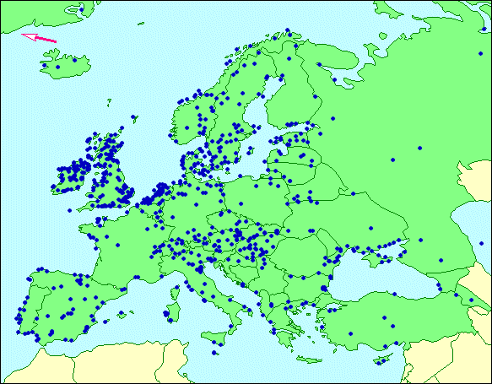
Ramsar sites
For wetlands and birds
Also classified as SSSIs

Slide 15

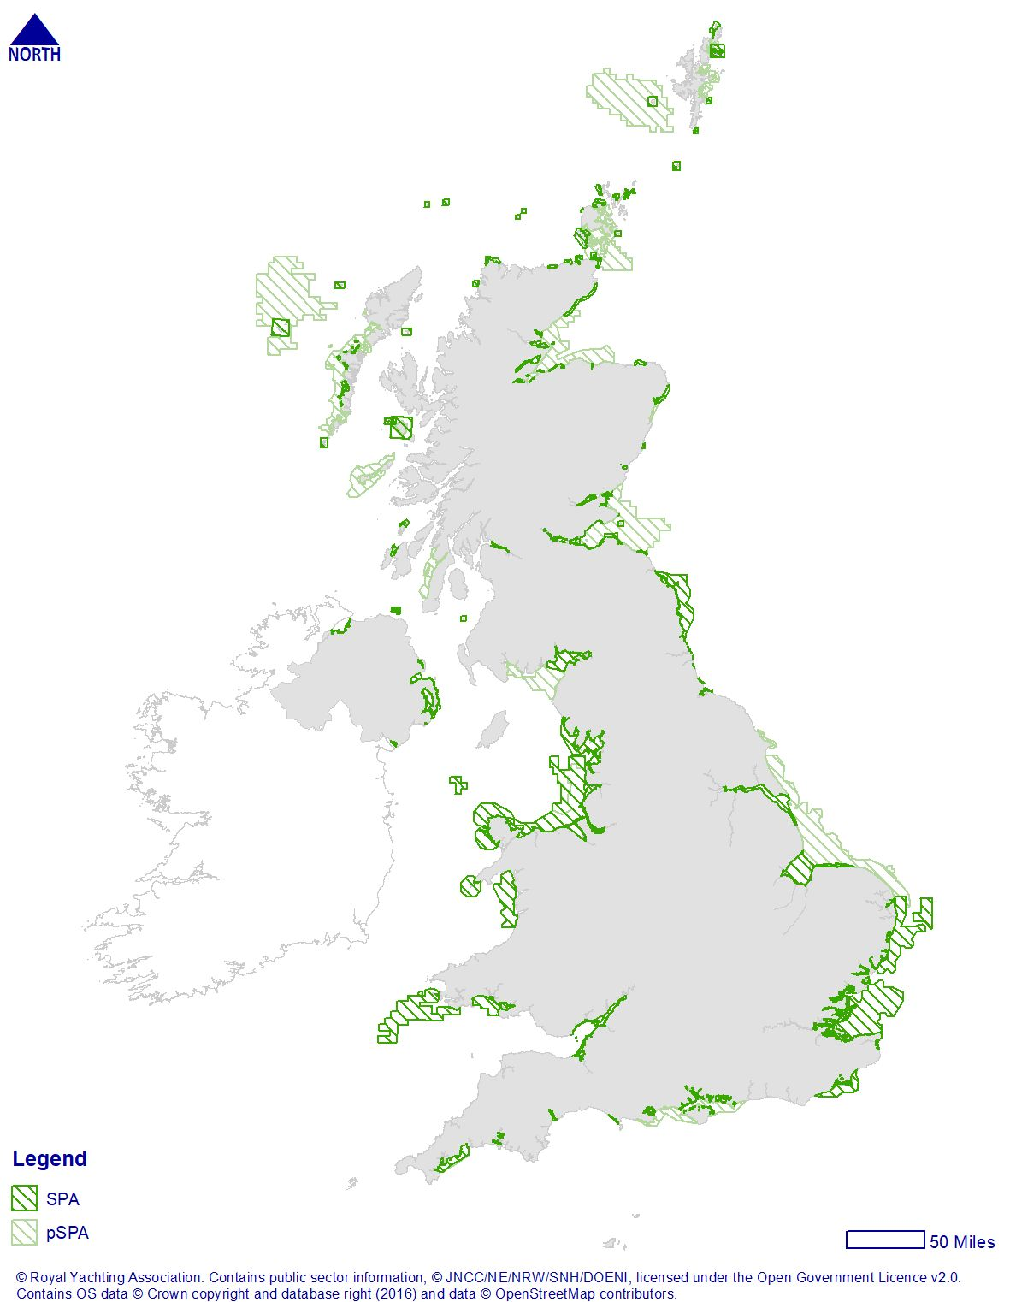
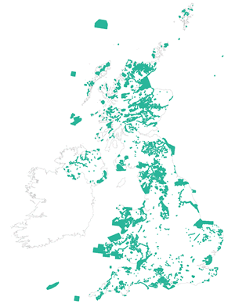
Special Protection Areas Special Areas of Conservation
More than 250 SPAs in the UK.. More than 650 SACs in the UK.
SPAs and SACs can overlap

Slide 16
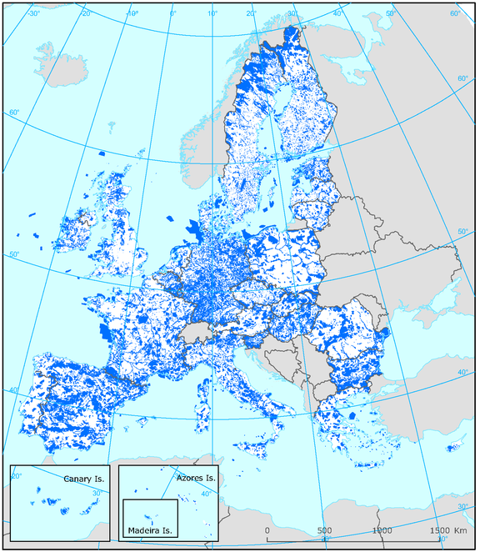

Natura 2000 sites (N2K)
Combines SPAs + SACs
Over 25,000 across Europe
~ 17% EU land surface

Slide 17
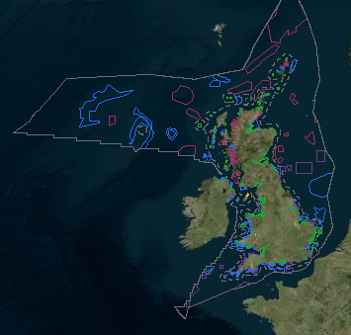
National Nature Reserves (NNRs)
Sites of Special Scientific Interest (SSSIs)
Marine Conservation Zones + other MPAs
17% of UK waters are within Marine Protected Areas
50 Marine Conservation Zones (National)
102 SPAs with marine components (Birds Directive)
99 SACs with marine components (Habitats Directive)

Slide 18


Local Nature Reserves – designated by Local Authorities
Local (County) Wildlife Sites – managed by NGOs

Slide 19
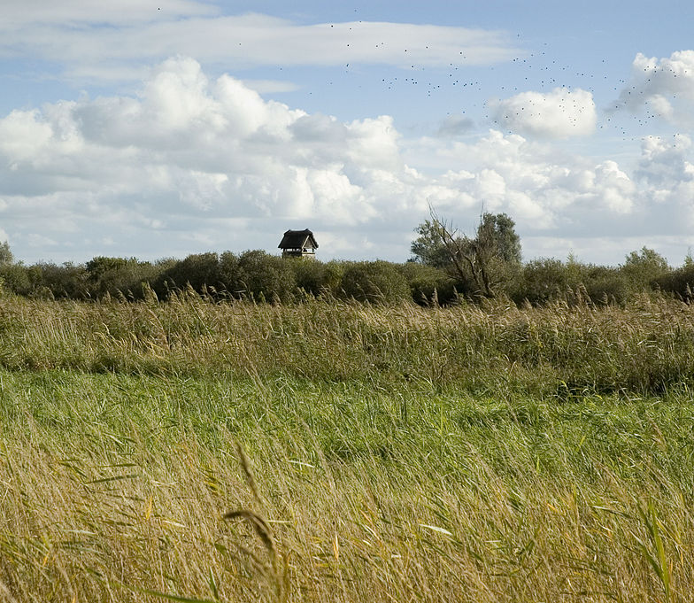
Sites often fall under several designations
Eg. Wicken Fen, Cambridgeshire
Ramsar (international)
SAC (EU)
NNR and SSSI (national)
National Trust (local)

Slide 20
Who is responsible for managing the UKs Protected Areas?

Slide 21

GOVERNMENTAL AGENCIES
Natural England form the environment sector of DEFRA (Department for Environment, Food and Rural Affairs)
Responsible for designating SSSIs and managing NNRs.
“Ensure the natural environment is protected and improved, including through delivery of Government’s financial incentives to farmers”

Slide 22


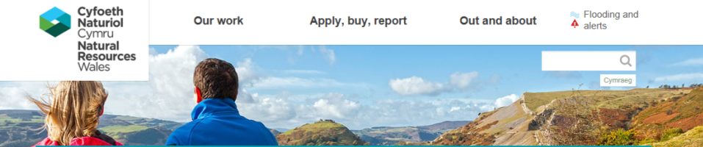
Responsibilities of the Environmental Agencies are broad:
Flood control
Boating & rod licences
Nuclear regulation
Pollution monitoring & regulation
Actioning EU Water Framework Directive
Oil Spills
But not related to the management of protected habitats or species.
GOVERNMENTAL AGENCIES

Slide 23



NON-GOVERNMENTAL AGENCIES
The UK has many long-established NGOs which play a major role in managing Protected Areas
Also important for:
Lobbying Government
Shaping policy and legislation
Conduct surveys and research
Educating and involving public

Slide 24
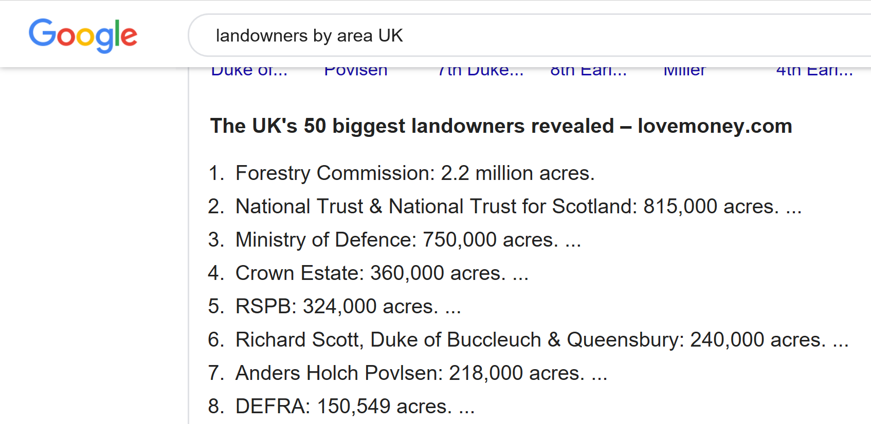
Who has the most land?
1 forestry commission, 2 rspbnational trust, 4 rspb 8defra

Slide 25

LOCAL COUNCILS AND PLANNING AUTHORITIES
Local Councils also manage small local reserves.
Planning Authorities ensure that new developments do not encroach on protected habitat or areas that support protected species:
Birds Directive Annex 1 Species
Habitats Directive Annex 4 Species
IUCN Redlist Endangered Species

Slide 26
In this week's LIVE session:…
You will learn how to use the NBN and MAGIC websites to source information about the protected habitats and species found in different parts of the UK.
These skills are used by ecological consultants when they are carrying out an Ecological Impact Assessment for proposed building developments.
They will also be useful for your assignment!

